Slide 1
OpenStudio Overview
May 6th 2016

Slide 2

Why OpenStudio?
Manipulating E+ is hard
Very few interfaces were being developed around E+
E+ is the most advanced open commercial research tool available

Slide 3
OpenStudio is not an interface…
Leverages expertise in any given organization to create an interface quickly based on their needs.
Created an SDK rather than an interface.
UI can exploit the SDK using C++, Ruby, Python, Javascript, etc
Originally created to be decoupled from the engine
Supports Radiance
ESP-r was partially implemented in C++
eQuest was partially implemented in Ruby
Interfaces have been created using HTML, GTK+, Node.JS with the same underlying data model.
Lets you create your own interfaces as simple or as complex as you wish.

Slide 4
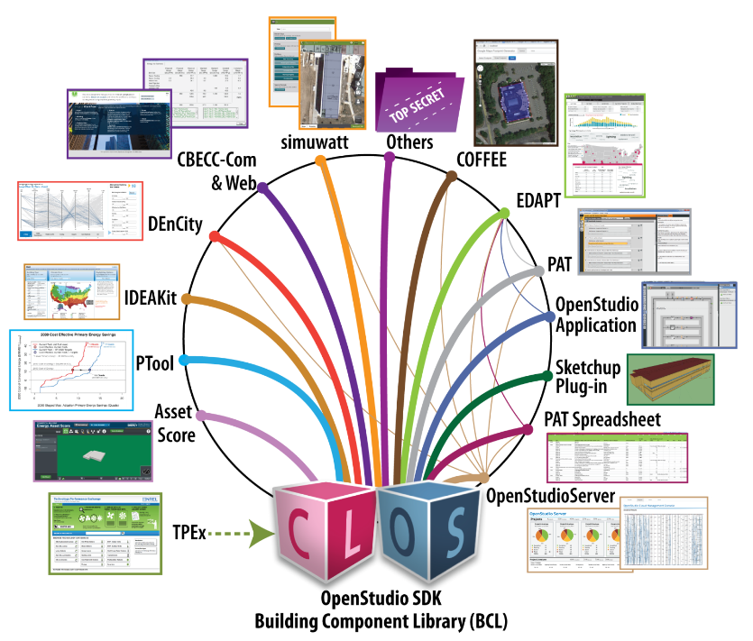
The OpenStudio Eco-system

Slide 5
Development
A tested developer release every 2 weeks.
A stable release every 3 months.
Supports development on all platforms (Linux, Mac, Windows)
Shared development between NREL, NRCan, PNNL

Slide 6
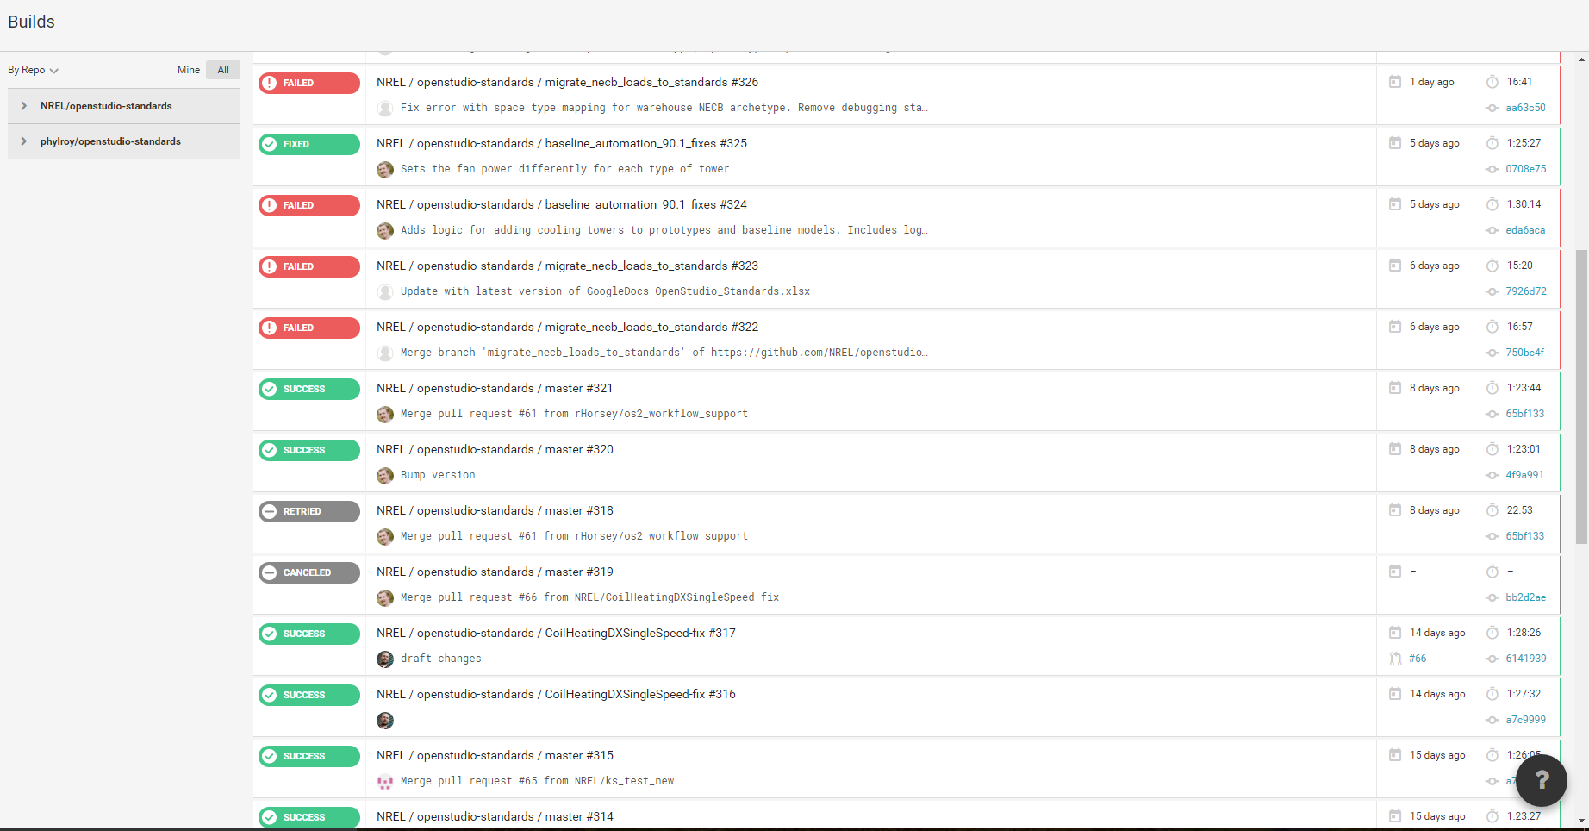
Automated Nightly Cloud Testing

Slide 7
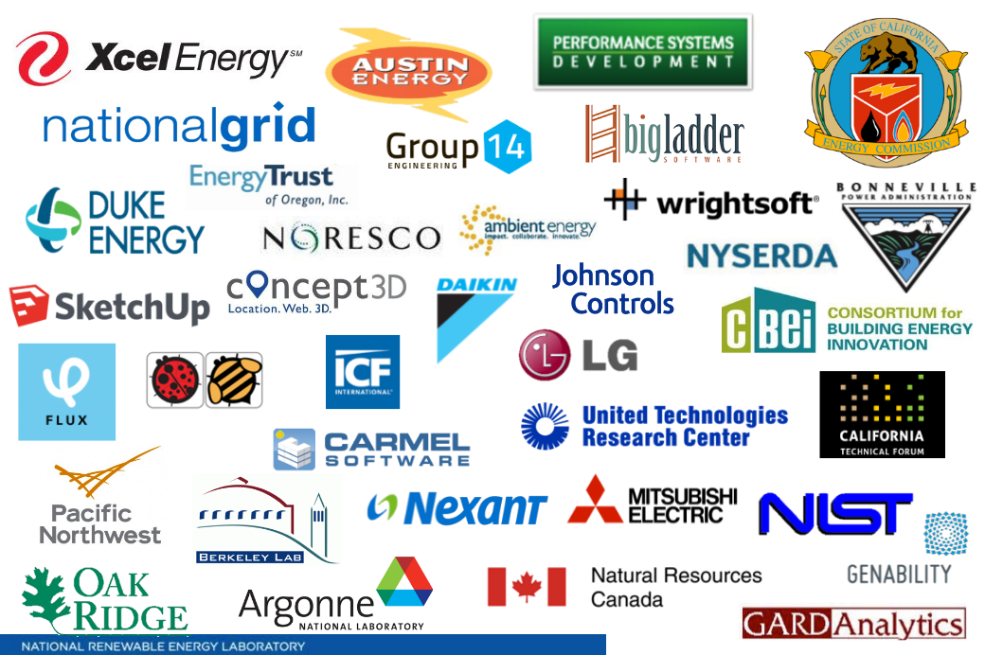
Partnerships

Slide 8
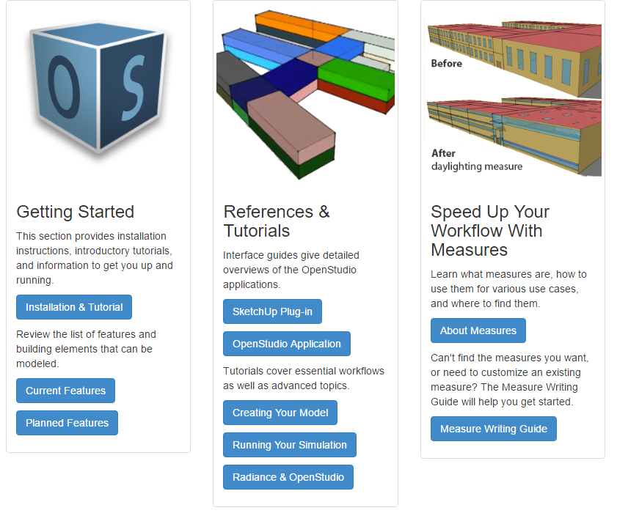
Learning Resources

Slide 9
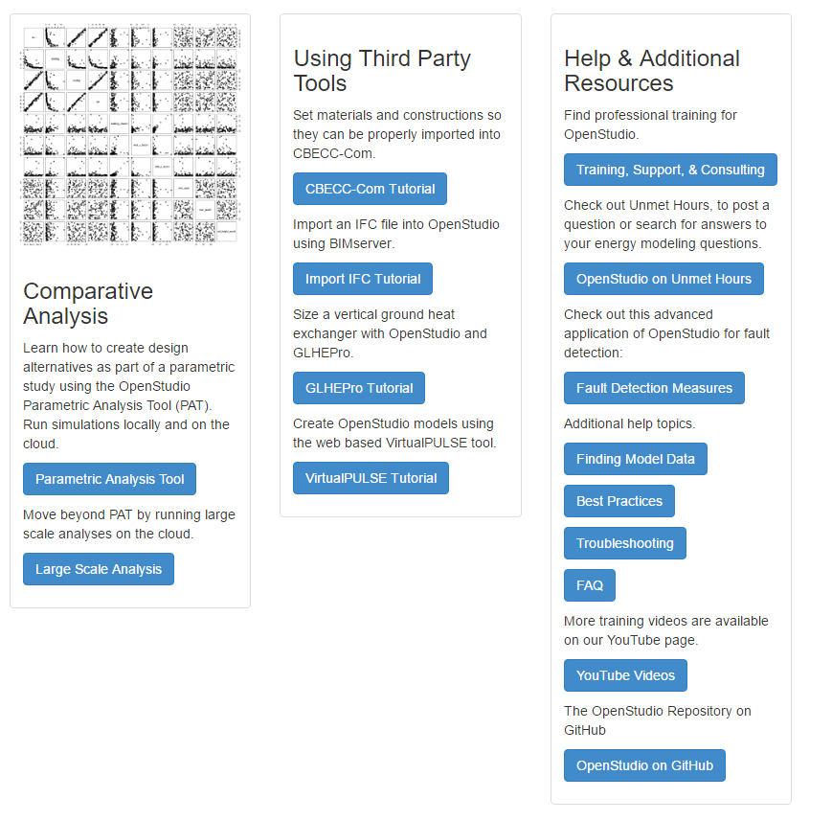
Learning Resources

Slide 10
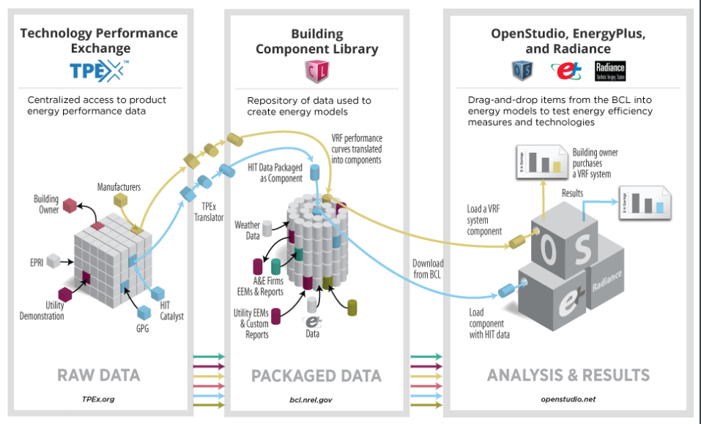
Modelling Resources

Slide 11
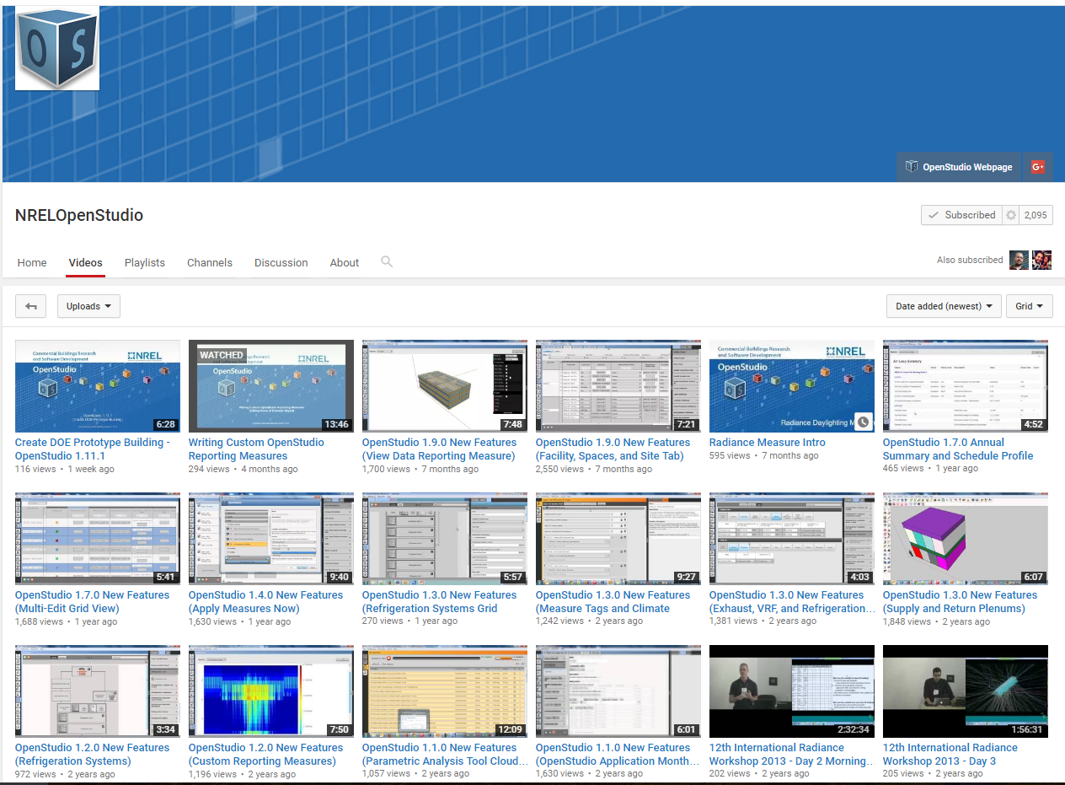

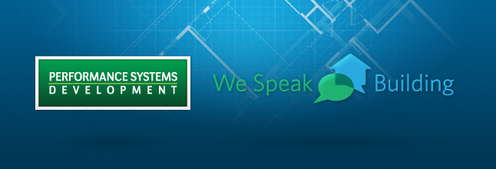
Other Resources
150 + Videos

